Slide 1
BIOMEDIN 215 Data Science in Medicine
Nigam Shah, MBBS, PhD
nigam@stanford.edu

Slide 2
Recap of your toolkit

Slide 3
Lectures 1, 2
Research questions and study designs
Where and why are data generated?

Slide 4
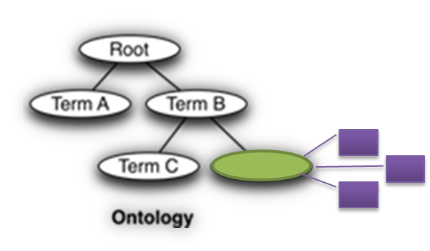
Lectures 3, 4
Ask about:
How are the data organized (i.e. what schema)?
Where do the data come from?
How can I access the data?
Where are the errors introduced?
Are the data useful for me? (exposures, outcomes, number of records)
Ask about:
Things
Names
Relationships

Slide 5
Lectures 5, 6
Transforming data into analysis ready datasets.
Feature spaces can be reduced using knowledge-graphs or via data-driven methods.
You can create new features from the raw data.
Missing data can be imputed with varying levels of sophistication (but be careful!).
Your effectiveness in doing these tasks will increase by knowing some biology and medicine.
Text is one source to mine
[be careful how deep you go!]
Notes:
How do you turn messy data into a dataset to analyze?
What is the impact of these methods on the answers we get to our clinical questions?

Slide 6
Lectures 7, 8
Data and questions span many timescales, with irregular time intervals
Ordering of events is crucial.
We can use time explicitly (time-series, time-to-outcome) or implicitly (binning)
Timing of exposures and outcomes is crucial. Get index time right.
Clinical processes are often nonstationary
Electronic Phenotyping = defining the necessary and sufficient conditions to accept that an exposure or outcome of interest occurred based on what you see in the patient timeline
Notes:
Stuff to worry about:
Repeated observations
Irregular time intervals
Large number of (sparse) features
Choices of binning
Choices of constructing features
The dimensions of electronic phenotyping: features, time, and definition complexity.
Think of: a feature dimension (i.e., what features are used to characterize a phenotype), a time dimension (does the representation support a time variant definition of the phenotype) and the definition complexity (how complex is the representation corresponding to a phenotype definition).

Slide 7
One slide summary of your tool-kit
The basics:
The anatomy of the healthcare system
The research questions and study designs
The sources of, and errors in, the data
Using knowledge graph/s of things, their names, and relationships
The choices:
The source and choice of features
How much to agonize over textual data
On the handling of time
In defining an electronic phenotype
In lectures 9 and 10 we reviewed the OMOP CDM, and how to query data stored in that schema at Stanford

Slide 8
The rest of the class – how to not be wrong
L-10
L-18
L-12, 13
L-15,16,17
L-14

Slide 9
Why is there a sudden surge of interest in analyzing clinical data?

Slide 10
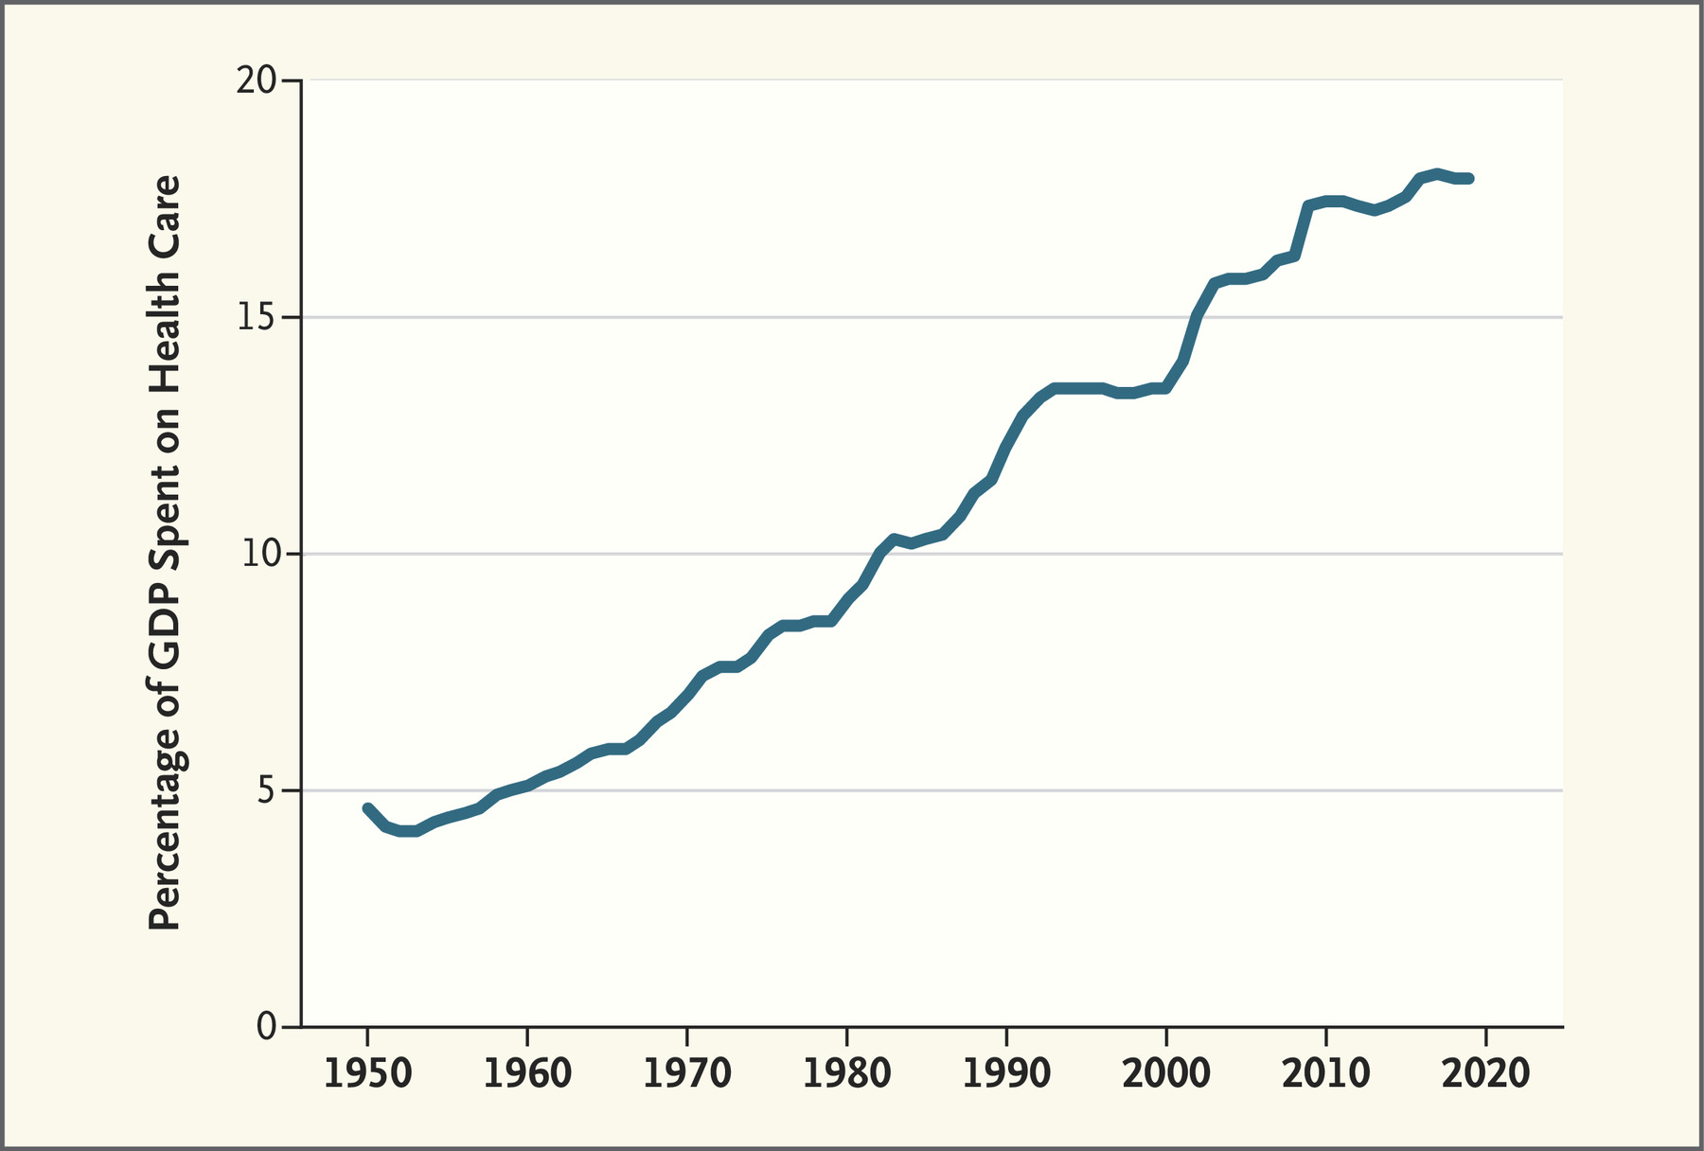
Skinner et al, N Engl J Med 2022; 386:709-711 | DOI: 10.1056/NEJMp2114227
Notes:
Ratio of National Health Expenditures to GDP, 1950 to 2019.
Data are from the U.S. Social Security Administration 1976 Compendium of National Health Expenditures Data and the Federal Reserve Economic Data database at the Federal Reserve Bank of St. Louis. GDP denotes gross domestic product.

Slide 11
Shrank et al, JAMA 2019
Category | Waste | Savings
Failure of care delivery | 102.4 – 165.7 | 44.4 – 93.3
Failure of care coordination | 27.2 – 78.2 | 29.6 – 38.2
Overtreatment or low value care | 75.7 – 101.2 | 12.8 – 28.6
Pricing failure | 230.7 – 240.5 | 81.4 – 91.2
Fraud and Abuse | 58.5 – 83.9 | 22.8 – 30.8
Administrative complexity | 265.6 | ?
Total | 760.0 – 935.0 | 191.0 – 282.0

Slide 12
There is a belief (hope?) that data science can help …

Slide 13
We use data from patient timelines …
Make a forecast
Pt.
Disease codes
Medication
Procedures
Imaging
Billing (claims)
Streaming data
Genome
Automate a task
Notes:
Feature-set completeness = Function (number, density, utility and resolution)

Slide 14
… to build models that help decide whether to act, or how to act
Decide whether to act
If (Risk > Th.)
then (do = X)
Guide choice of how to act
Notes:
These two examples are the kinds of decisions that form the core of clinical care. I jokingly refer to the construct on screen as the “equation of medicine”. In any given situation, a clinician has to assess multiple such risk-equations, and if the risks are above a certain threshold (which is often left undefined) then take the appropriate actions.
The way machine learning can help is by solving a risk stratification problem which aids the decision of whether to act (think Laura) or by solving a treatment recommendation problem which aids the decision of how to act (think Vera).

Slide 15
Models can be built to advance the science, practice or delivery of care
Science
Practice
Delivery
Classify (Diagnose)
…
Who might be at high risk for a blood clot?
…
Whether to treat
Predict (Prognose)
…
…
…
Recommend (Decide)
…
What is a good second line drug for diabetes after metformin?
…
How to treat
Notes:
Science:
Classify = Finding subtypes of heart failure with preserved ejection fraction
Predict = Increased Monocyte Count is marker for bad prognosis in fibrotic diseases
Delivery:
Classify = Who is burnt out?
Predict = Who will be a no show?
Recommend = Request four back up nurses on Wed, for the Ortho OR.

Slide 16
Decide whether to act
Predominantly Predictive
Causality optional
If (Risk > Th.)
then (do = X)
Predominantly Inferential
Causality matters
Guide choice of how to act
Notes:
Mention “digital biomarkers” (e.g. typing speed as a proxy for alzheimers)
Annotate the slide with lectures (12, 13, 14 → choice of how to act and 15, 16, 17 → choice of whether to act)
Last week to “catch up” … the class accelerates in terms of concepts/ideas per lecture by at least 5X.
Phase shift in terms of giving information to “making sense”

Slide 17
The two cultures
Inferential - data modeling
Predictive - algorithmic modeling
Estimate parameters:
Y= f(X_{1…i}, noise, parameters)
Learn a function:
f(x)—that operates on x to predict y.
Worry about :
Significance – is there a measurable difference?
Effect size – is the measured difference relevant?
Worry about :
Accuracy – how often do I get it right?
Actionability – I got it right, so what?

Slide 18
Statistical inference
Aims to infer properties of a population given a smaller, observable sample
sampling
Data
x_{s} | y_{s}
0.12 | 12
… | …
19 | 1900
0.2 | 20
Data-generating process
inference
Focus on:
How big is θ? (parameter estimation) … effect size
Are we sure θ is not 0? (hypothesis testing) … significance testing
Notes:
Associative analysis methods (aka measures of association) enable comparison between groups to determine if the observed incidence or prevalence of an event is statistically significant, that is significantly different from what would be expected by chance if the event was not at all associated with the factors you’re investigating.
Attribute MedStats

Slide 19
Supervised Learning
features
(e.g. patient characteristics)
target
(e.g. patient outcome)
X_{new}
f(X)
Learning Algorithm
Model
observations
(e.g. patients)
X
y
y_{pred}
“Training Data”
A model is a map from input to output: mathematically, a function
We implicitly assume there is a real “data generating function”, which is unknown, and that is what we are trying to represent
Notes:
If y is a continuous measurement, the task is called regression
If y is a category or class label, the task is called classification

Slide 20
An example (descriptive)

Slide 21

250 million patients
Hripcsak et al, PNAS 2016
Notes:
Now doing this for Oncology

Slide 22
An example (inference)

Slide 23
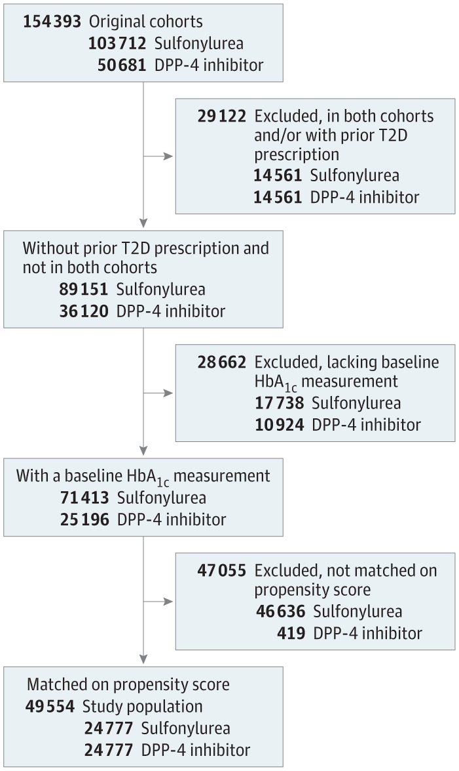
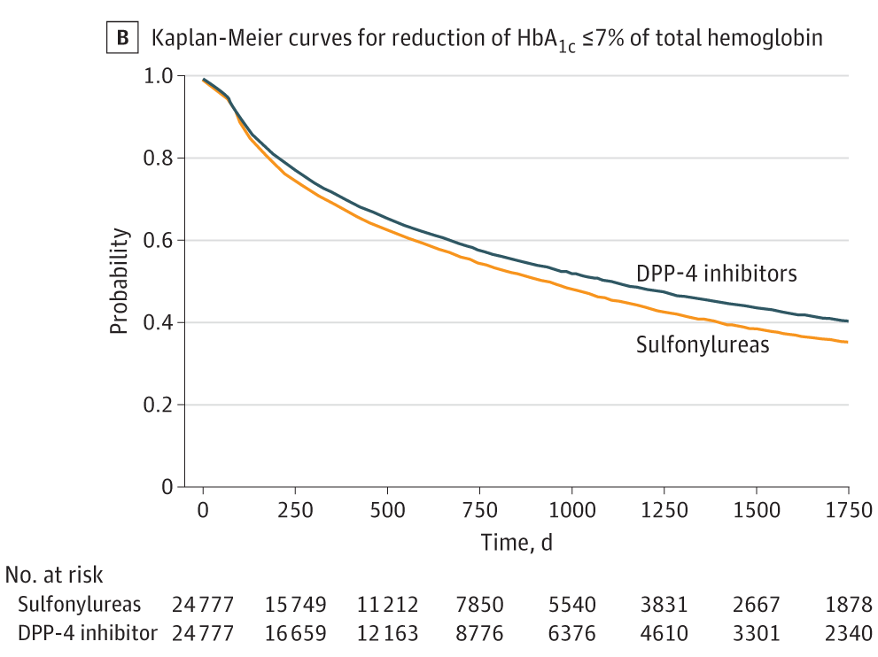
Association of Hemoglobin A1c Levels With Use of Sulfonylureas, Dipeptidyl Peptidase 4 Inhibitors in Patients With Type 2 Diabetes Treated With Metformin
Notes:
https://jamanetwork-com.laneproxy.stanford.edu/journals/jamanetworkopen/fullarticle/2698083?resultClick=1

Slide 24
Let’s calculate relative risk and odds ratio
We are concerned about the potential fatal adverse event of a drug, 5 out of 11 individuals who took the drug had a heart attack, compared with 1 out of 11 individuals who did not take the drug.
Risk: the rate of experiencing the outcome. a/(a+b)
Odds: the chance of experiencing the outcome relative to not experiencing the outcome. a/b
Take 2 minutes to calculate the odds ratio and the relative risk
Notes:
Risk: the rate of experiencing the outcome
Odds: the chance of experiencing the outcome relative to not experiencing the outcome
Relative risk (RR): a measure of the risk of an outcome in a group compared to another group
Odds ratio (OR): a measure of the odds of the outcome in a group compared to a control group
Relative risk and odds ratio diverge when the outcome is common
Why is the odds ratio used more often?
Can be calculated from case-control study data, where it is not possible to calculate risk ratio because prevalence of outcome in the sample is unknown (defined by the study inclusion criteria)
Output of logistic regression (more on this later). If you do a logistic regression to measure the effect of multiple variables on a binary outcome, you get the odds ratio “for free”
And, you get a big looking number!

Slide 25
Most important decision
 |  | Outcome
 |  | + | -
Exposure | + | a | b
 | - | c | d
Include people with alternative indications
Include people on alternative Rx (or no Rx, most common Rx …)
Notes:
Based on the findings from mini-sentinel, OMOP efforts;
Bottom line was that choice of C, D cell matters more than choice of methods.

Slide 26
Criteria of evaluation
Size of the effect
Significance of effect
How likely is it to be true
How likely am I to be wrong

Slide 27
An example (prediction)

Slide 28
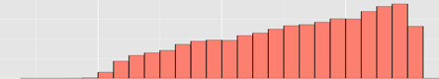
Predicting delayed healing wounds
1,182,751 wound assessments
spanning 5 years
2013
2008
68 Healogics Wound
Care Centers in 26
states
59,958 patients
180,716 wounds
Each wound assessment:
Age
Gender
Insurance
Zip code
Wound type
Wound location
Dimensions
Edema
Erythema
Rubor
Other wound qualities
Center Code

Slide 29
Clinically usable performance
Advanced care decisions for specialists
Screening for referral
Notes:
Prev efforts are at 0.68-0.73, and for only 2 or 3 wound types.
GBM = 0.857
KMLM = 0.803
Lasso = 0.839
RF = 0.847
But amputations are very rare (~1% of wounds) so hard to get good PPV.
GBM = 0.9032
Lasso = 0.900
RF = 0.9152

Slide 30
Let’s calculate a PPV
If a perfectly sensitive test to detect a disease whose prevalence is 1/1000 has a false positive rate of 5%. What is the chance that your patient with a positive result actually has the disease, assuming you know nothing about the patient's symptoms or signs?
Take 2 minutes to calculate the chance of the person to have the disease

Slide 31
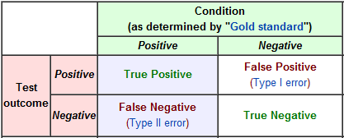
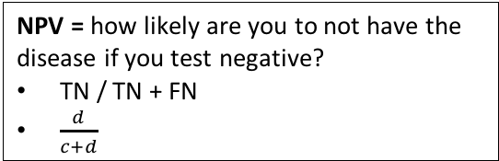
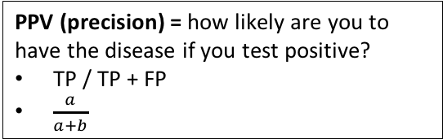
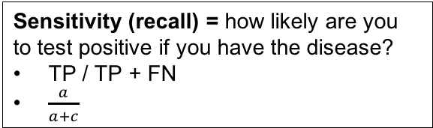
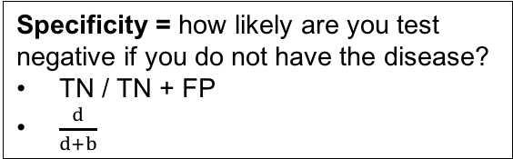
Criteria of performance
PPV (precision) = how likely are you to have the disease if you test positive?
TP / TP + FP
$\frac{a}{a+b}$
NPV = how likely are you to not have the disease if you test negative?
TN / TN + FN
$\frac{d}{c+d}$
Sensitivity (recall) = how likely are you to test positive if you have the disease?
TP / TP + FN
$\frac{a}{a+c}$
Specificity = how likely are you test negative if you do not have the disease?
TN / TN + FP
$\frac{d}{d+b}$
Notes:
Precision is intricately tried to prevalence. For things that are rare – e.g. you colleague being a terrorist – even a good model will still not tell if you if he or she is or is not a terrorist in reality.

Slide 32
A prediction is only as good as the action it triggers or prevents
Prediction
date
Time of event
0 min – N years
Patient’s Medical Record
Observed timeline
Window to take some action
Notes:
Cover difference between prediction and classification

Slide 33
An example (causal)

Slide 34
Assigned reading
Bradley Efron (2020)
Prediction, Estimation, and Attribution,
Journal of the American Statistical Association, 115:530, 636-655

